Slide 1
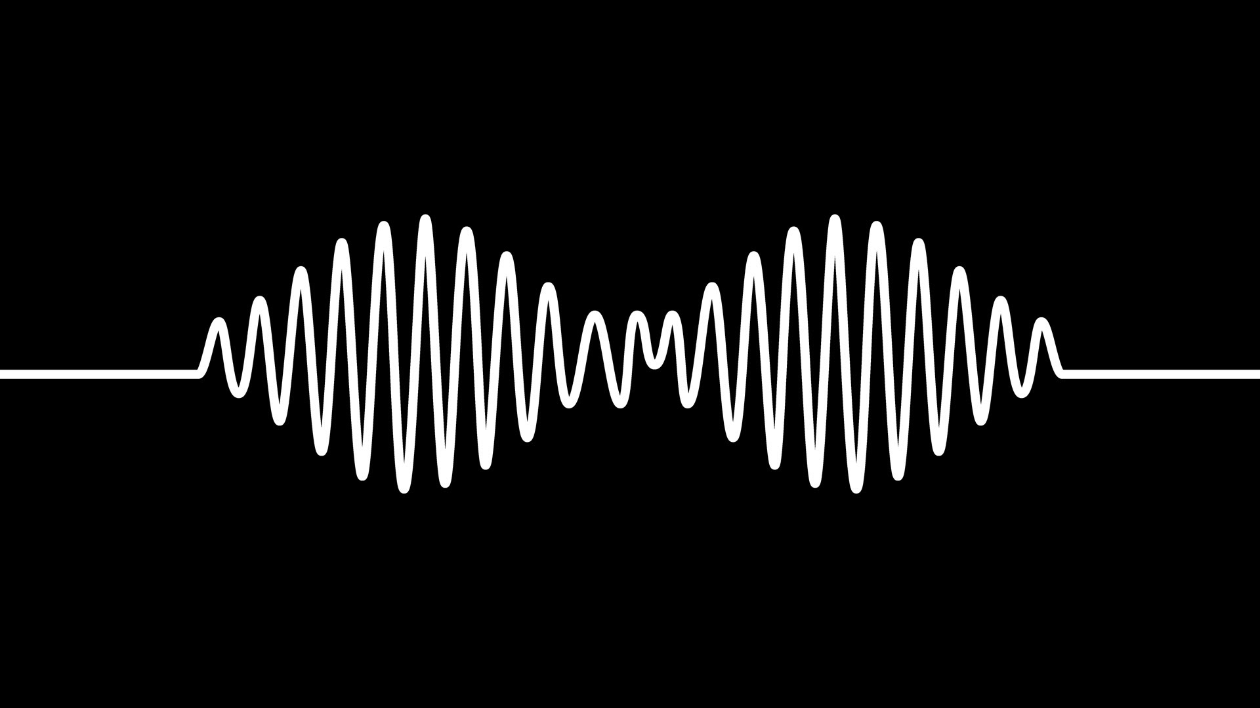

Pi Sonification
Capitol Technology University
CubeSat Bootcamp Summer Program 2016
Rebeca Nunes Rodrigues
Rodrigo J. de Bem
Marcelo Moreira Nicoletti
Felipe Alexandre L. de Abreu
Notes:
Good morning. Our names are *** and we will show the results of the Pi Sonification project.

Slide 2


Sonification
Data
Sound
Notes:
Concept of sonification: Sonification is the transformation of raw data into sound. It is used either for interpretating the data by a different point of view or for analysing this data in real time without having to deal with graphics.

Slide 3

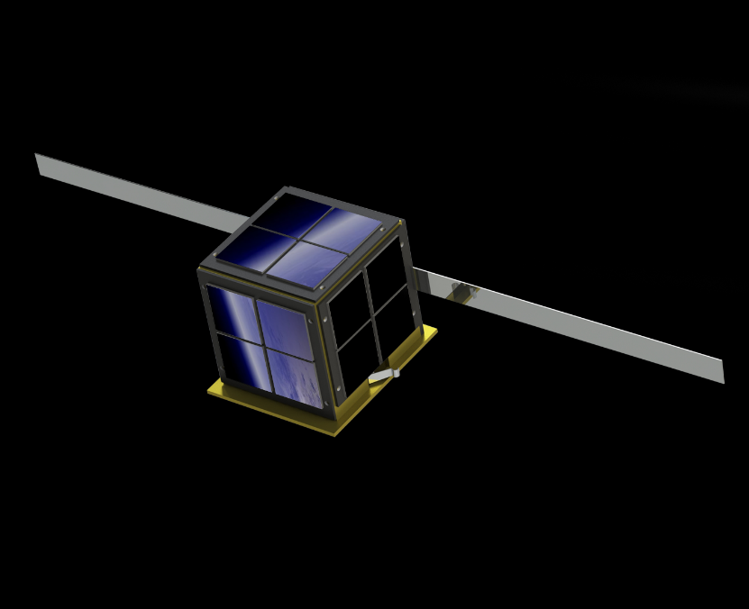

Cubesats – Project overview
FTP
Data (Temperature & Light)
Sound (Midi file)
Notes:
The Project: in this project, we simulated the communication between a nanosatellite and a ground station. A raspberry was used as the nanosat and a computer as the ground station. The data recovered from the nanosat are the light and temperature sensors’ data. The sound file recovered is a .midi file. The downlink is simulated by FTP.

Slide 4
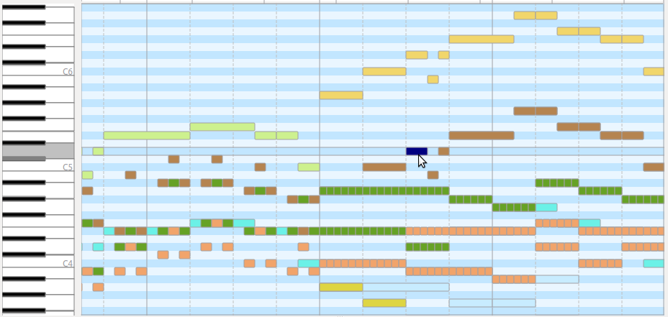
The MIDI files
Command based file
Notes:
Midi files: they are files that store a series of commands with instructions to play several notes. It is like a paper containing all the keys someone have to play in a keyboard in order to produce a music. Moreover, it shows the keys and “how to play” each key (wich intensity and for how many seconds).

Slide 5
The MIDI files
Command based file
Very small size
(.wav, .mp3 are way bigger)
Notes:
Midi files: a great advantage of the MIDI files are their size. They are very small compared to a full audio file.

Slide 6
The MIDI files
Command based file
Very small size
(.wav, .mp3 are way bigger)
Command are called Events
Notes:
Midi files: each command, in a general way, is called an “Event” that occour formation of the music.

Slide 7
The MIDI files
Command based file
Very small size
(.wav, .mp3 are way bigger)
Command are called Events
Can be converted to
several instruments
Notes:
Midi files: other advantage of the midi files is that they can be played by the computer as it were played in a instrument of your choice.

Slide 8
The MIDI files
For each “Event”
(command):
Velocity (amplitude)
Notes:
Events on a midi file: the velocity characterizes the amplitude (or the volume or the strenght) of the note that is played.

Slide 9
The MIDI files
For each “Event”
(command):
Velocity (amplitude)
Pitch (frequency)
Notes:
Events on a midi file: the pitch characterizes wich note is played (if it is a C or D or B#), i.e., the frequency that is being played.

Slide 10
The MIDI files
For each “Event”
(command):
Velocity (amplitude)
Pitch (frequency)
Tick (start time)
Notes:
Events on a midi file: the tick characterizes when a note begins to be played after the last event.

Slide 11

Temperature and Light to MIDI
-Software built in the
raspberry
-Easy programing
synthesizor
First tries: Sonic Pi
Notes:
In order to transform the data in sound, the Sonic Pi software was one of the first attempts to make the conversion.

Slide 12
Temperature and Light to MIDI
-Conversion from Light and
Temperature to sound was ok
First tries: Sonic Pi
Notes:
Done: convert temp and light to sound, but does not store

Slide 13
Temperature and Light to MIDI
-Conversion from Light and
Temperature to sound was ok
-Problem: Synthesizes
the sound, but does not
Store midi file
First tries: Sonic Pi
Notes:
Done: convert temp and light to sound, but does not store

Slide 14
Temperature and Light to MIDI
-Conversion from Light and
Temperature to sound was ok
-Problem: Synthesizes
the sound, but does not
Store midi file
-Possible solution: Synthesize
in the server
First tries: Sonic Pi
Notes:
Done: convert temp and light to sound, but does not store

Slide 15
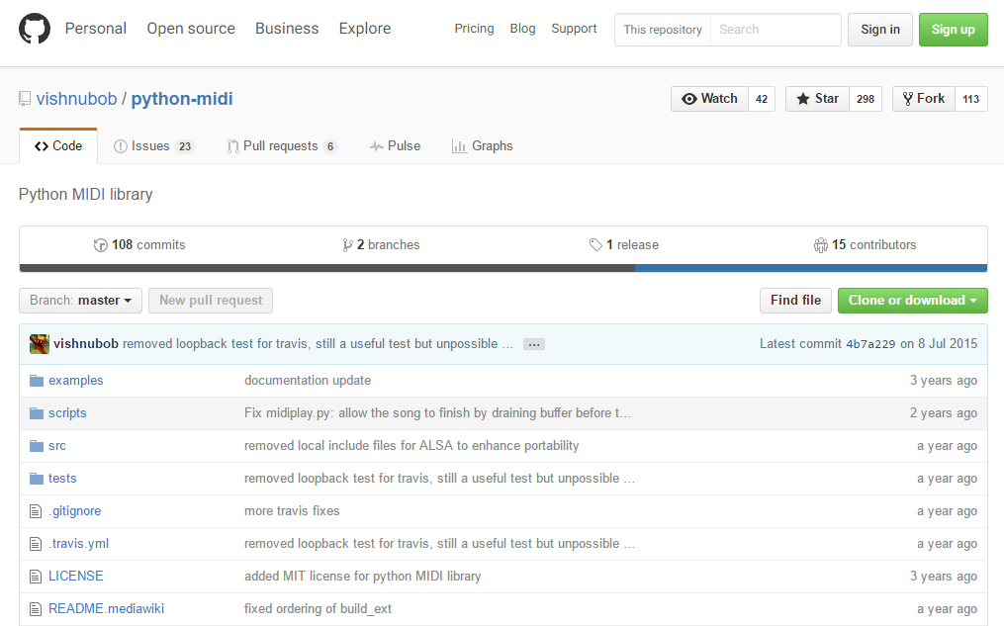
Temperature and Light to MIDI
Python-MIDI library
Notes:
Python-midi library: found on github by rodrigo after search for different MIDI libraries. Showed to be the best.

Slide 16
Temperature and Light to MIDI
midi.Pattern()

Slide 17
Temperature and Light to MIDI
midi.Pattern()
Light
Temperature
midi.Track()
midi.Track()

Slide 18
Temperature and Light to MIDI
midi.Pattern()
Light
Temperature
midi.Track()
midi.Track()
Event 1
Event 1
Event 2
Event 2
Event 3

Slide 19
Temperature and Light to MIDI
midi.Pattern()
Light
Temperature
midi.Track()
midi.Track()
Time_yyyy-mm-dd_HHhMMmSSs
Event 1
Event 1
midi.write_midifile()
Event 2
Event 2
MIDI file
Event 3

Slide 20
Temperature and Light to MIDI
midi.Pattern()
Light
Temperature
midi.Track()
midi.Track()
Time_yyyy-mm-dd_HHhMMmSSs
Event 1
Event 1
midi.write_midifile()
Event 2
Event 2
MIDI file
Create new for each
70 notes
Event 3

Slide 21
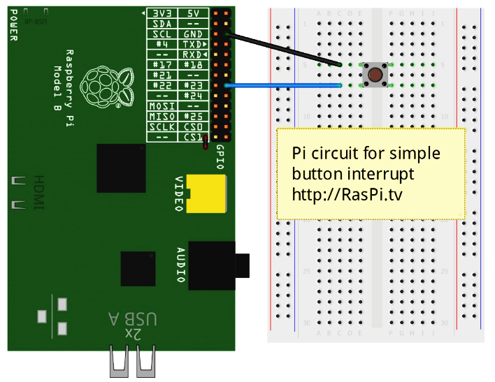
Command to downlink: interrupt
import RPi.GPIO as GPIO
GPIO.setup(17, GPIO.IN, pull_up_down=GPIO.PUD_UP)

Slide 22
Command to downlink: interrupt
import RPi.GPIO as GPIO
GPIO.setup(17, GPIO.IN, pull_up_down=GPIO.PUD_UP)
Each time a interrupt is called, the downlink function
is called:
-Send to ground station (PC) via FTP
-Delete all midi files stored in the nanosat (Pi)

Slide 23
Downlink: File Transfer Protocol
FTP
import ftplib

Slide 24
Downlink: File Transfer Protocol
FTP
import ftplib
Client
Server

Slide 25
Downlink: File Transfer Protocol
FTP
import ftplib
Client
Server set up
Linux:
-Straigthforward
Windows:
-Install FileZilla
-Configure it
-Set rule on firewall

Slide 26
Conclusion / Comments

Slide 27
Thank you
Capitol Technology University
CubeSat Bootcamp Summer Program 2016
Rebeca Nunes Rodrigues
Rodrigo J. de Bem
Marcelo Moreira Nicoletti
Felipe Alexandre L. de Abreu

